Slide 1
AOA: An Overview and Insight on the Value of Membership

Slide 2
Welcome
Speaker Name & Credentials, AOA Champion
Notes:
Welcome! Thank you for taking time out of your busy schedules to meet with me today.
-Brief introduction about yourself
***Disclaimer:***
I am here today, as a volunteer, to present on a topic that I am very passionate about. The AOA has been a professional home to me for close to {amount of years you’ve been an AOA Member} years now. While I will be presenting on the AOA today, I am not a representative of the AOA. I am sharing this as your peer in the hopes that providing this connection and information will help to bring you as much support as I have received. I will be sharing a sign-up sheet, where you can choose to share your information if you would like some additional information sent to you following this presentation, in addition to sharing the contact information to get in touch with the AOA staff.

Slide 3

About the AOA
National Professional Organization
Serving Osteopathic Physicians, student physicians and their patient community for 125+ years
Supporting DO’s and DO students through: Organized Medicine, Accreditation, Certification, CME, Advocacy and Public Health Policy
  1901: First scientific journal published
  1927: Monthly osteopathic medicine magazine, The DO
  1957: Official accrediting body for medical education
  1966: Accrediting body for osteopathic hospitals
Notes:
Established in 1897 by Andrew Taylor Still as the American Association for the Advancement of Osteopathy in 1901, it was renamed as American Osteopathic Association and the first scientific journal was published.
Serving DOs and student DOs for 125+ years
Supporting 186,000 osteopathic physicians and students
Established in 1897, including CME, advocacy, health policy
1901: First scientific journal published – and continues today as the Journal of Osteopathic Medicine
1957: Official accrediting body for medical education
1966: Accrediting body for osteopathic hospitals under Medicare
1967: Official accrediting agency for all aspects of osteopathic medical education

Slide 4
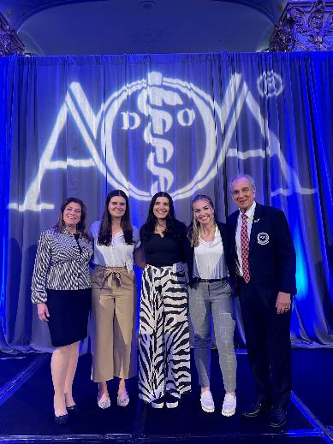
AOA Mission & Vision
Serving DOs and student DOs for 125+ years
Professional Home for osteopathic physicians and students
Champion of the advancement of the osteopathic profession
Advance the interests of osteopathic physicians and students
Promote excellence in patient care
Provide continuing education
Board certification
Notes:
The AOA’s Mission Statement is:
The AOA is the professional home for osteopathic physicians and students, providing education, board certification and is the champion of the advancement of the distinctive osteopathic profession.
The AOA’s Vision Statement is:
The AOA aspires to be the “North Star” of the osteopathic profession by advancing the interests of osteopathic physicians and students and promoting excellence in patient care consistent with the distinctive osteopathic philosophy.

Slide 5
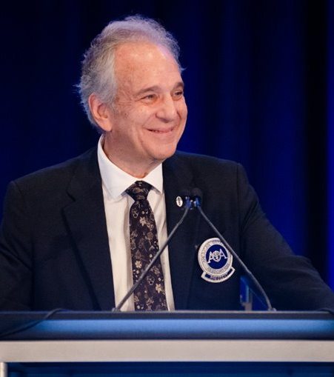
AOA Presidential Goals
AOA FY24 Presidential Goals
  Enhance the value of AOA Membership
  Refine and promote the unique value of AOA board certification
  Create strategic budgeting process to align AOA’s resources
  Establish strong working relationships with key strategic partners
Notes:
Each year following the AOA’s Annual Business meeting in July, AOA leadership convene to develop pertinent goals for the year ahead based on our five-year strategic plan. We determine how we can best work together to advance the AOA and the osteopathic profession – where we can make the biggest impact and how we can best serve our community of Patients, DOs, and osteopathic medical students.
Let me share with you the goals that were identified as top priorities for the AOA, and related activities.
The First Initiative under Dr. Monka’s presidency is to: Enhance the Value of AOA Membership
The Second Initiative is to: Refine and promote the unique value of AOA board certification
The Third Initiative is to: Create strategic budgeting process to align AOA’s resources
The Fourth Initiative is to: Establish strong working relationships with key strategic partners.

Slide 6
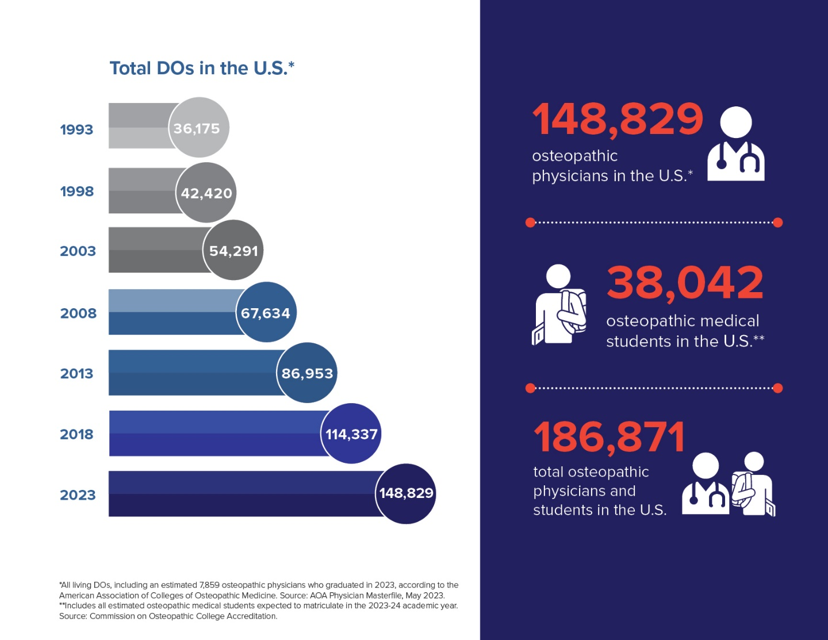
Growth in the Osteopathic Profession
7,850+
DOs joined the physician workforce in 2023
Osteopathic medicine
has grown:
77% in past decade 81% overall increase
Osteopathic medicine
has grown:
77% in past decade 81% overall increase
30%
increase in number of osteopathic physicians during the past five years
11%
of the U.S. physician population is composed of DOs
Notes:
I’m excited to share some recent stats with you that demonstrate the growth of our profession – which leads to greater opportunities, awareness and influence for DOs in the healthcare community and beyond.
According to the AOA’s latest Osteopathic Medical Profession (OMP) Report, released in July 2023, we now have more than 186,000 DOs and osteopathic medical students in the U.S. – that number has quadrupled during the past three decades.
The osteopathic profession plays a critical role in addressing health disparities and will contribute greatly toward addressing the predicted physician shortage expected to reach between 37,000 and 124,000 physicians in the next decade, according to data from the Association of American Medical Colleges (AAMC).
More prospective physicians than ever before are choosing osteopathic medicine, with more than 38,000 DO students enrolled at osteopathic medical schools this academic year. More than 25% of current medical students in the U.S. attend an osteopathic medical school – and this number continues to grow.

Slide 7
Expansion Across Specialties
57%
Primary Care:
of DOs practice in primary care fields
Osteopathic medicine
has grown:
77% in past decade 81% overall increase
Osteopathic medicine
has grown:
77% in past decade 81% overall increase
Non-Primary Care:
43%
of DOs practice in non-primary care specialties
Notes:
Not only is our profession growing, but we’re expanding further into all areas of medicine with each passing year.
We continue to maintain our strong base in primary care, but more DOs than ever before are choosing to practice in non-primary care specialties. This enables us to expand our osteopathic principles and practices across all areas of medicine.
Data reported through the 2023 NRMP Match showed DO placements across a wide range of specialties where DOs haven’t had a significant presence before, including neurosurgery, orthopedic surgery and neurology.

Slide 8
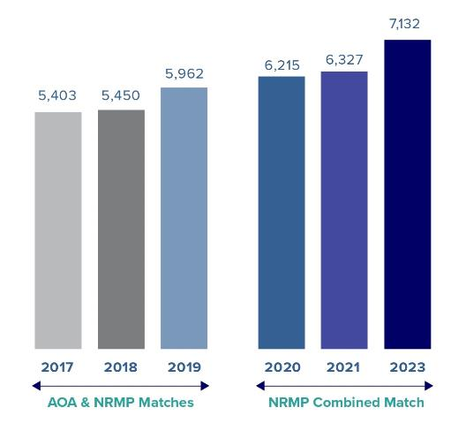
Bright Future for Postdoctoral Trainees
2024 NRMP Match
92.3% Match rate
8,033 DO seniors
0.7% increase from 2023
Record-breaking 2023 NRMP Match Placement
99.5% final placement rate for DO seniors
37 specialties
Name of Meeting – Month Date, Year (ie: ABC Meeting – January, 18, 2024)
Notes:
[This slide is updated following the SOAP to share “final placement” numbers for the Match, but the 2024 “Match” rate is included.]
I’m pleased to report that a record high number of 7,705 osteopathic medical students and past DO graduates matched into year 1 (PGY-1) residency positions through the National Resident Matching Program (NRMP). This number reflects a 92.3% match rate for the 8,033 DO seniors who participated, a 0.7% increase from last year.
As we look at growth in the profession, one of the AOA’s biggest priorities is ensuring a bright future for those who make the decision to become a DO.
Approximately 26% of all medical students in the U.S. today have chosen to practice osteopathic medicine. When the five-year transition to a single accreditation system for graduate medical education was completed, the AOA announced its commitment to ensuring training opportunities for our osteopathic graduates, and I’m happy to report today that they remain steadfastly focused on that mission.
In 2020, the first combined NRMP Match since the transition to a single accreditation system began, resulted in a record high number of residency placements for osteopathic applicants. The next two years continued to top previous numbers. And this year, they were topped again, with an all-time high total of 7,132 DO students and graduates matching into residency programs in 37 specialties.
These numbers demonstrate not only that osteopathic graduates are being welcomed into training programs, but their distinctive perspective and skills are being sought across a wide spectrum of specialties, paving the way for further expansion of osteopathic principles and practice throughout the House of Medicine.

Slide 9





Equity in Rotations and Residencies
Medical Student Parity
Addressing underlying issue
Joint statement recognizing equivalence
ACGME action on equitable residency selection
Program Director meetings
ERAS and VSLO filter and participation policies
Name of Meeting – Month Date, Year (ie: ABC Meeting – January, 18, 2024)
Notes:
Furthermore, the AOA has been working with key stakeholder organizations to address discrimination against DO students and trainees. While there are various initiatives for equity in rotations and residencies at different levels of the organization, I’m proud to report on the gains that have been made. The AOA is in the process of bringing key stakeholders together from both sides of the aisle to establish an equitable plan for all trainees.
The AOA’s goals are to provide:
Universal acceptance of COMLEX-USA exam
Equitable treatment of DO applicants to training programs
A new resolution on decreasing osteopathic bias in residency and fellowship applications, introduced by Emma York, DO, will be submitted to the AMA Interim meeting in November, pending agreement by the Resident and Fellow section.
Its goal is to ensure equal consideration of Osteopathic medical students and residents for residency and fellowship positions, in part by eliminating the use of discriminatory ERAS filters that unfairly exclude applicants who took the COMLEX exam series by program directors.
Reduction of medical training biases
New draft standards for GME – you will learn more about this from Genie James, VP of Accreditation
Advocacy for DOs and their credentials

Slide 10
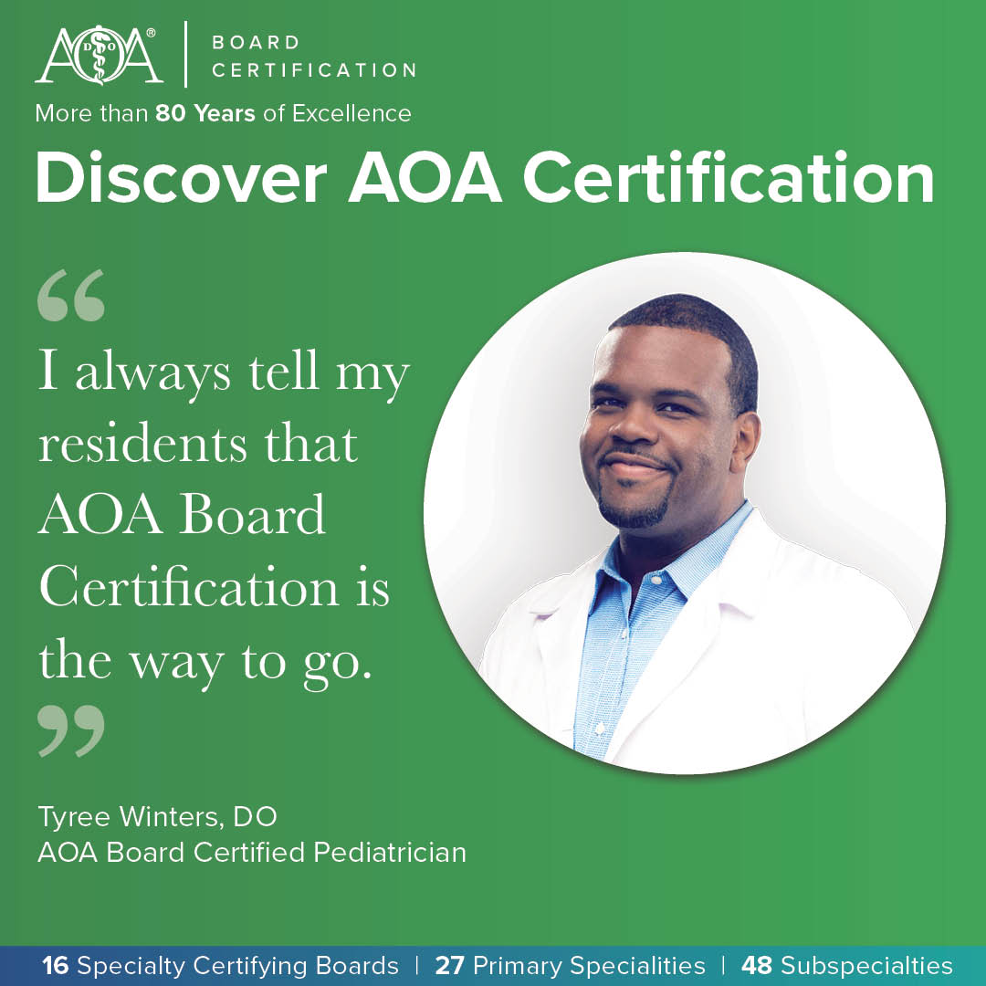
Osteopathic Board Certification
Establishing AOA Board Certification as the certification of choice for DOs​
  80-year tradition of excellence​
  Indicator of clinical distinction​
  Qualification for ACGME program directors and faculty​
  Outcome measure for ACGME residents and fellows
certification.osteopathic.org
Notes:
Now I’d like to provide some updates on some of the ways the AOA is working to serve it’s members, partners, and the profession.
AOA Board Certification is one of the Presidential Goals where they’ve been working to build value over the past several years.
The AOA continues working across all 27 primary specialties and 48 subspecialties to make our certification processes (both for initial certification and Osteopathic Continuous Certification) more flexible and convenient, while at the same time adding currency and relevance.
OMT DESIGNATION:
The AOA board certification's multi-specialty Distinct Osteopathic Examination Committee (DOEC) recently developed an exam for all AOA board certified physicians and they are very excited to provide the opportunity for all specialties to have OMT added to their AOA Board Certification. AOA board certified family physicians, have always recognized OMT. It is something to be very proud of.
NOW, all DOs from any specialty can have their OMT skills formally recognized! The new designation has two required parts: a written exam and a hands-on OMT performance exam, which is the same exam that AOBFP administers. The written exam will consist of 70 multiple choice questions written by the DOEC, and the performance exam will require the demonstration of the appropriate OMT technique for three unique cases.

Slide 11
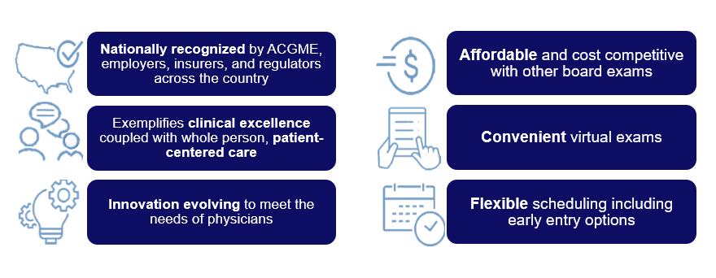
Innovating Osteopathic Board Certification
Notes:
AOA Board certification is accepted in the ACGME requirements for faculty members qualifications, and AOA board pass rates are included as an outcome measurement for all ACGME programs.
AOA is recognized by employers, insurers, and regulators across the country, just like ABMS.
Exemplifies clinical excellence coupled with whole person, patient-centered care
AOA is always innovating and evolving to meet the needs of physicians
AOA board certification is Affordable and cost competitive with other board exams
All exams are offered virtually – so you can not have an additional expense of traveling to a conference or testing center for your board certification.
They also offer flexible scheduling and FM and IM certification has an early entry option where you can be AOA board certified as soon as you complete residency.

Slide 12

Continuing Medical Education
Joint Providership Program​
AOA is an ACCME-accredited provider​
On-demand enduring OMED content​
OMED21: 9 specialty colleges​
OMED22: 17 specialty colleges​
OMED23: All 21 specialty colleges​
Learning Management System​
AOA Online Learning services available for osteopathic organizations without an LMS​​
Osteopathically Distinct CME Task Force​
Representatives from AOSED, SOSE and other CME sponsors​
Notes:
On the CME front, the AOA continues working to innovate the learning experience and assist our osteopathic affiliate partners in the development and presentation of high-quality osteopathic CME.
On-Demand enduring OMED programming – available to all specialty colleges!
Joint Providership –
The AOA launched its Joint Providership program in 2021.
Since launch of the program, the AOA offers the following options for CME accreditation:
AOA Category 1A, 1B, 2A and 2B; as well as
AMA PRA Category 1 Credit
AOA Online Learning –
Osteopathic organizations without an online Learning Management System (LMS) can leverage the AOA Online Learning platform to deliver on demand osteopathic CME.
Osteopathically-Distinct CME Task Force –
Established in Summer 2021, the AOA task force was convened with representatives from AOSED, SOSE and other CME CME sponsors charged with developing a definition of osteopathic CME, as well as content requirements for AOA Category 1-A - with the goal of ensuring the distinctiveness of osteopathic CME offerings across the profession.

Slide 13
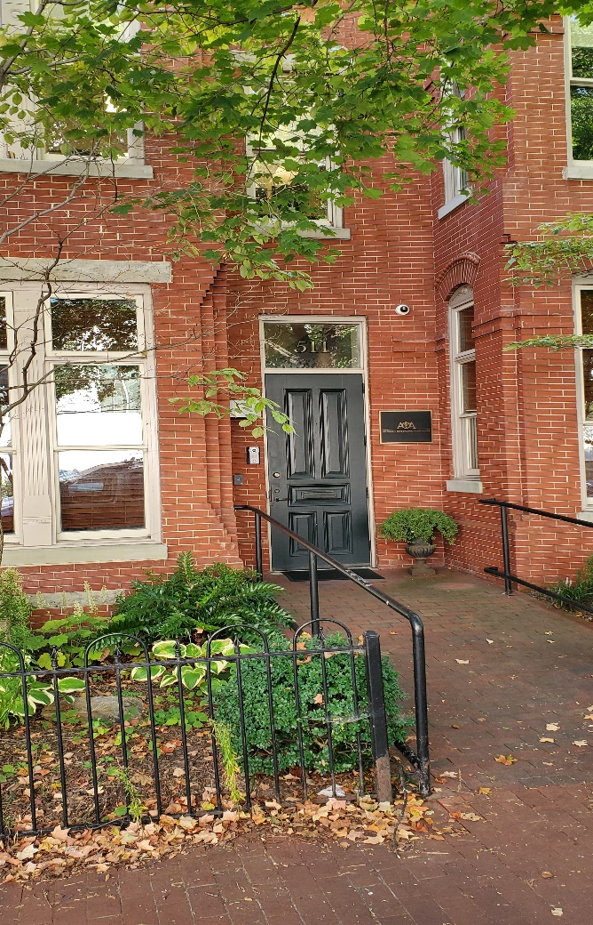
Federal and Grassroots Advocacy
State & International Government Affairs​
Scope of practice, licensure and liability protection​
Regulatory Affairs​
Dr. Lorna Breen Health Care Provider Protection Act, Medicare cuts, physician payment, HIT​​
Congressional Affairs​
Prior authorization reform in Medicare Advantage, surprise billing, liability protection, debt relief​
Grassroots​
Access to care, entitlement reform, regulatory reform, scope of practice, physician workforce
AOA D.C. headquarters
Notes:
Another important way the AOA works to advance the osteopathic medical profession is through Advocacy.
The AOA is the only organization representing the interests of ALL osteopathic physicians, regardless of specialty or practice type, at the federal and state levels – ensuring your voice is heard and lawmakers understand the distinctive approach DOs bring to the practice of medicine.

Slide 14

Federal and Grassroots Advocacy
Recent highlights:​
$1.44 billion six-year reauthorization of the Teaching Health Center Graduate Medical Education (THCGME) program​
Funding for 200 additional Medicare-funded GME positions​
Prevention of cumulative 8.5% cut to Medicare payment rates​
Extension of Medicare telehealth services​
Appointment of a DO to the CDC’s Healthcare Infection Control Practices Advisory Committee
Notes:
During the past year, the AOA and its partners achieved several notable federal advocacy wins on behalf of the profession. Many of these efforts provided opportunities to collaborate closely with osteopathic affiliate partners, including state associations and specialty colleges.
Some examples of our advocacy work at the federal and grassroots levels include:
• The historic $1.44 billion six-year reauthorization of the Teaching
Health Center Graduate Medical Education (THCGME) program
being reported out of the House Committee on Energy and
Commerce. The program invests in the training of physicians
in community settings and helps attract physicians in rural and
medically underserved areas.
• Enactment of legislation that includes funding for distribution
of 200 additional Medicare-funded graduate medical education
residency positions.
• Prevention of cumulative 8.5% cuts to Medicare payment rates
that were scheduled to take effect in 2023.
• A two-year extension of numerous Medicare telehealth services
that were temporarily available during the COVID-19 Public
Health Emergency.
• Appointment of a DO to the Centers for Disease Control and
Prevention’s Healthcare Infection Control Practices Advisory
Committee, which helps guide the Department of Health and
Human Services and CDC on infection control practices.
And others... (if time permitting)
• Finalization of CMS rules to improve prior authorization (PA)
in Medicare Advantage, including changes that align PA
requirements with Medicare fee-for-service coverage rules.
• Enactment of legislation requiring states to provide children with 12
months of continuous coverage under Medicaid and the option for
states to provide 12 months of continuous postpartum coverage.

Slide 15

Strategic Partnerships
Building relationships with health care partners to serve our communities
  Federal agencies​
  National organizations​
  Corporations​
  Affiliate organizations
Notes:
The AOA also works to advance the osteopathic medical profession through partnerships with federal agencies, national organizations, corporations and affiliate organizations.
Federal Agencies
Department of Health and Human Services Initiatives - The AOA is partnering with the US Department of Health and Human Services to promote the We Can Do This COVID-19 public education campaign. The AOA is in a nationwide network of trusted medical and public health organizations that serve as messengers for the campaign.
Centers for Disease Control and Prevention – The AOA is participating in the CDC’s Community Preventive Services Task Force (CPSTF), which includes many national organizations and agencies to provide evidence-based findings and recommendations about community preventive services, programs, and other interventions aimed at improving population health.
US Army – The US Army has participated as sponsorship for OMED.
National Organizations
Association of State and Territorial Health Officials (ASTHO) – COVID-19 prevention and vaccinations.
Association of Immunization Managers - COVID-19, influenza prevention and vaccinations.
Behavioral Health Initiative Collaborative Partnership on Mental Health with the American Medical Association, American Academy of Child & Adolescent Psychiatry, American Academy of Family Physicians, American Academy of Pediatrics, American College of Obstetricians and Gynecologists, American College of Physicians, and American Osteopathic Association and the American Psychiatric Association.
Families Fighting Flu – Partnership on influenza partnership activities.
Sepsis Alliance – Partnership on sepsis prevention.
National Hispanic Medical Association – Influenza prevention partnership.
Pharmaceutical Research and Manufacturers of America – Partnership on public policy activities.
Corporations
Merck – Partnership and grant funding on HPV cancer prevention, pneumococcal Immunization, COVID-19 and health disparities and managing heart failure.
Sanofi – Partnership and grant funding on influenza and RSV prevention.
Pfizer – Partnership and grant funding on COVID-19 prevention and treatment.
Eli Lilly and Company (Lilly) – Partnership, sponsorship and grant funding for public policy activities and diabetes education.
Genentech -Partnership on OMED symposium.
Boehringer Ingelheim Pharm., Inc. - Partnership on OMED symposium.
AOA’s Patient Safety and Quality Improvement Advisory Group
ACOOG – the AOA worked to extend Medicaid health care coverage for pre-natal patients for one full year following a child’s birth
AMOPS – establishing partnership with executive director
Affiliate Organizations:
Florida Osteopathic Medical Association
Michigan Osteopathic Association
Ohio Osteopathic Association
Oklahoma Osteopathic Association
Pennsylvania Osteopathic Medical Association
Other initiatives with Affiliates in progress
Exciting news is the growth of our profession……….
One of the Key partnerships is between the AOA and SOMA to build long-term relationships with the osteopathic physicians of tomorrow.
Some of the current SOMA priorities are:
Continued advocacy for non-legislative solutions for GME parity (FAIR Act) – to include
Advocacy for equitable institutional fees for student rotations and recognition of COMLEX - USA
Public Health Crises and Health Equity (overdose/addiction, firearm safety, access to care, food insecurity, mental health, physician/medical student wellbeing)
Increasing opportunities for student representation within the AOA volunteer structure

Slide 16
Partnering for Public Health
Initiatives:
  HPV cancer prevention
  Pneumococcal immunization
  COVID-19 prevention and treatment
  Health disparities
  Heart failure, diabetes education, public policy activities and more
  AOA’s Patient Safety and Quality Improvement Advisory Group
Toolkits:
  Flu Prevention
  Social Determinants of Health
www.osteopathic.org/flu-prevention
www.osteopathic.org/SDOH
Notes:
Over the past couple of years, the AOA has greatly increased the resources provided to DOs for communicating with patients on public health initiatives.
Topics include:
Flu Prevention
Vaccines
Social Determinants of Health
Several of these initiatives involved collaboration with partners across the osteopathic profession:
The AOA developed physician toolkits full of resources for educating your patients on flu prevention and preparing yourself and your team to address social determinants of health. Both toolkits can be accessed on Osteopathic.org.

Slide 17
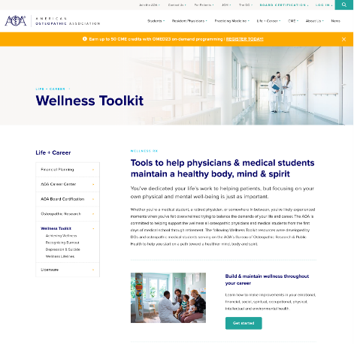
AOA Wellness Resources
Caring for YOU is our top concern.
Tools you can use:
On-demand wellness webinars
AOA member discounts on wellness apps
COVID-19 wellness resources
Substance abuse and mental health services
www.osteopathic.org/wellness-toolkit
Notes:
Another important topic I want to highlight today. It’s important to address physician and student stress and burnout.
Being a physician or student isn’t always easy. There are very high rates of burnout and depression in the medical profession, and it’s more important than ever for us to take care of ourselves using the tools and resources available through the AOA and other organizations.
Check out our resource center on our website – you can find it @ www.osteopathic.org/physician-wellness. The toolkit includes information on where to seek help, how to combat burnout, clinician support tools and AOA member discounts for wellness apps and other resources.

Slide 18

Invest in Your Future
AOA Membership
Notes:
This brings me to my favorite topic: AOA Membership.

Slide 19

Unlock a World of Benefits with the AOA by Your Side
The AOA is THE organization that serves as the professional family for more than 186,000 DOs and medical students, working to advance the distinctive philosophy and practice of osteopathic medicine around the world.
AOA members not only support the profession and its future, but also have access to exclusive member benefits.
Notes:
The AOA is THE organization that serves this profession through advancing the distinctive philosophy and practice of osteopathic medicine.
By becoming an AOA Member, and maintaining your membership, you are making a commitment to the continued growth in our profession, the AOA, and yourself. In honor of AOA Members, and to acknowledge your commitment to the profession, the AOA has a large variety of Membership Benefits to directly assist you.

Slide 20
AOA Member Benefits: Education & CME
Access to CME tracking and reporting tools:
  24/7 access to your AOA CME Report with tracking ($199/$299 value)
  Personalized My CME member dashboard – a NEW benefit
  CME self-reporting through your members-only portal ($199/$299 value)
Centralized CME calendar and search tool for AOA Category 1 courses
Free or discounted courses through the AOA Online Learning portal
  Complimentary JOM quizzes released monthly ($264 annual value)
  Waived CME Category 1B Conversion Fee ($25 value per course)
CME counseling and support
Notes:
Perhaps one of the most known benefits of AOA Membership is the education and CME opportunities.
AOA Members receive complimentary access to their AOA CME Reports. This service will cost non-members anywhere from $199 to $299 annually based on their board certification status with the AOA.
In fact, there is a brand new membership feature, the My CME member dashboard, that brings your AOA CME Report, the ability to self-report your own credits (which allows you to bypass longer CME processing times at the end of any CME Cycle), and new personalized CME recommendations based on your board certification requirements for CME all in one place.
Members also receive free and discounted CME opportunities such as taking the JOM monthly quizzes for CME credit at no charge (whereas non-members will pay $22/per quiz per month), and waived conversion fees for Category 1B (where non-members will pay $25 per course requested)
As we see the value add up, I’d like to mention one service that I feel is truly invaluable to members, and that is the AOA’s Member Resource Center and CME Specialists. AOA staff are able to support members with personalized counseling and support, and this benefit brings a peace of mind that is worth the cost of membership alone.

Slide 21

AOA Member Benefits: Publications & News
Stay up to date with the latest news and research from the AOA:
  Journal of Osteopathic Medicine (JOM) research, including opportunities to get published
  The DO, the AOA’s news & features publication
  DO Engage osteopathic advocacy newsletter
  My AOA mobile app – your one-stop-shop for osteopathic news, education & connection (exclusive member content)
Notes:
The AOA also goes out of their way to provide Members with the latest news and research through:
The Journal of Osteopathic Medicine
The DO
DO Engage
And the My AOA mobile app
Upon joining, the AOA’s Member Resource Center can assist you with navigation, signing up, and making sure these resources are at your fingertips.

Slide 22

AOA Member Benefits: Advocacy & Awareness
Ensure protection of your osteopathic distinctiveness:
  Federal & state public policy advocacy to protect practice rights
  Advocacy for international practice rights
  The AOA’s brand campaign to promote and raise public awareness of osteopathic medicine
  Inclusion in the Find Your DO directory
Notes:
The AOA is the national and professional organization that will relentlessly advocate and fight for our rights to ensure the protection of our osteopathic distinctiveness on:
Both a federal and state level
For our International practice rights
Through brand campaigns to raise public awareness of osteopathic medicine
And through the inclusion of your business information in the AOA’s Find A DO directory to ensure your visibility for patients looking for a DO near them. (This membership benefit can easily be removed for physicians that are not interested in having their practice information publicly posted. To request this, please contact the AOA’s Member Resource Center.)

Slide 23

AOA Member Benefits: Professional Development & Networking
Expand your network & grow leadership skills:
  Eligibility for AOA leadership positions
  Eligibility to serve in AOA House of Delegates
  My AOA mobile app communities & discussions
Notes:
By becoming an AOA member, you’ll enjoy countless opportunities to build leadership skills, exchange ideas and collaborate with like-minded physicians
Membership benefits include:
Eligibility for AOA leadership positions
Eligibility to serve in the AOA House of Delegates
My AOA mobile all communities and discussions
And so much more!

Slide 24

AOA Member Benefits: Career Advancement & Resources
Propel your career with the AOA Career Center:
  Employer and job-seeker resources
  CV and personal statement assistance
  Discounted employment contract review services (10% off)
Notes:
Outside of the Professional Development and Networking membership benefits, the AOA also provides its members with career advancement opportunities and resources.
The AOA Career Center has
Both employer and job-seeker resources
CV and personal statement assistance
And discounted employment contract review services

Slide 25

AOA Member Benefits: Board Certification & Licensure Support
Manage and maintain your requirements:
  Free AOA Profiles (Physician Profile Reports) to send to state licensing boards ($25 value per report)
  Information on U.S. State licensure and requirements for offering telemedicine
  Resources and guidance to help you achieve and maintain AOA Board Certification
Notes:
AOA Members also receive additional support and value with AOA Board Certification and licensure.
In fact, AOA Members receive complementary profiles that can be sent to any state licensing boards. Non-members will pay $25 per profile sent, so if you’re planning on applying for state licensure, especially for multiple states, this benefit can come in handy.

Slide 26

AOA Member Benefits: AOA Annual Events
Receive discounted rates for AOA events
  OMED, the #1 osteopathic education conference
    Earn up to 60 AOA Category 1 CME credits or AMA PRA Category 1 credits
    17% savings on registration ($200 value)
  DO Day, the profession’s largest advocacy event
    Earn up to 10-15 AOA Category 1-A CME credits or AMA PRA Category 1 credits
    57% savings on registration ($340 value)
Notes:
Members also receive very generous discounts off AOA Annual Events such as the annual OMED Conference and DO Day.
Year after year, the educational content is praised, as is the accessibility of earning so many AOA Category 1 CME credits in such a short period of time. To best meet the needs of our Members, the AOA continues to hold in-person events, but also now has added virtual and on demand offerings for both of these events. Based on the feedback of members and attendees, the annual OMED Conference and DO Day, are also available to participate in virtually, with extended access so that participants can take advantage of the content around their schedules. The On-Demand availability for these events are always posted online and mentioned in outgoing communications.

Slide 27

AOA Member Benefits: Practice Support
Receive expert practice management support:
  Coding and billing assistance
  Contract negotiation guidance
  Exclusive practice management webinars
  Business of medicine resources
Notes:
The AOA’s Physician Services Team is available to members to assist with issues, concerns, questions regarding the day-to-day operations of a medical practice.
This can include coding, billing and issues with insurers, HR problems, starting or closing a practice, telemedicine.
They meet with the top 5 commercial insurance carriers on a scheduled basis, other insurers as needed, to discuss AOA members’ concerns.
They also offer non-clinical CME education and anything else non-clinical that impacts a practice.

Slide 28

AOA Member Benefits: Research
Stay on the cutting edge of osteopathic research:
  Access to the Osteopathic Research Database
  Eligibility for AOA research grants & awards
Notes:
Some of you may find additional value with access to the Osteopathic Research Database, and eligibility to AOA research grants and awards.

Slide 29

AOA Member Benefits: Discounts & Savings
Explore the AOA Member Value program:
  Financial services
  Practice management & marketing tools
  Entertainment & travel
  Moving services
Notes:
Last, but certainly not least, I’d like to highlight the AOA’s Member Value Program. This program has vast offerings of resources in a variety of areas to help you save. They have savings on:
Financial services
Practice management and marketing tools
Entertainment and travel
Moving services
And so much more!

Slide 30

What’s the Value of AOA Membership?
If you’re a member who attends OMED and DO Day, takes monthly JOM quizzes, sends one AOA Profile to a state medical board and uses the AOA CME Report, then you’re already saving $1,028 per year compared to non-members!
Notes:
Now that we’ve briefly reviewed the Membership benefits, I’d like to highlight where the value of Membership comes in. Each of you may have already noted a number of benefits that you may be interested in taking advantage of. To paint a picture on how much you can save, I’ll note this example:
If you plan on attending OMED, DO Day, taking advantage of some of the free or discounted CME with opportunities like the JOM quizzes each month, sending a single profile to a state medical board, and accessing your AOA CME Report, you can save over $1,028 a year compared to our non-members! Don’t believe me, let’s add this up together.
If you attend DO Day this year, members receive a $340 discount
If you attend OMED this year, members receive a $200 discount (that’s $540 worth of savings already)
If you need to access your AOA CME Report, that would cost a non-member $199/$299, whereas members receive this for free. (We’re now up to $739/$839, based on your board certification status. Please note that this now exceeds the cost to be a member.)
If you want to take advantage of the monthly JOM quizzes, a non-member would pay $264 for a years worth of quizzes, whereas this is free for members. (The total is now up to $1,003/$1,1003)
If you send 1 AOA profile, a non-member would pay $25, this again is free for members. (This total is now up to $1,028/$1,128).
Keep in mind, this total doesn’t count potential savings in the Member Value Program, Scholarship or Grant opportunities, Practice Support from the Physician Services Team, Staff support from the MRC, and so much more.

Slide 31

Group Memberships
Unlock discounted AOA benefits with Group Membership
  The AOA recently launched customized Group Membership packages to organizations and/or health systems that supports DOs’ success and their profession.
  Maintaining your skills and staying up to date on advancements in patient care, health technology and the business of medicine helps to develop a mutually beneficial foundation for success for you and your employer.
Notes:
Individual Membership is not the only way to become a member of the AOA. To stay on top of industry trends, and the ever-evolving needs of our Members, the AOA has also created Group Membership options for organizations or health systems that are interested in personalized packages to best support their DOs’ success and the profession.
Maintaining your skills and staying up to date on advancements in patient care, health technology, and the business of medicine helps to develop a mutually beneficial foundation for success for you and your employer.

Slide 32
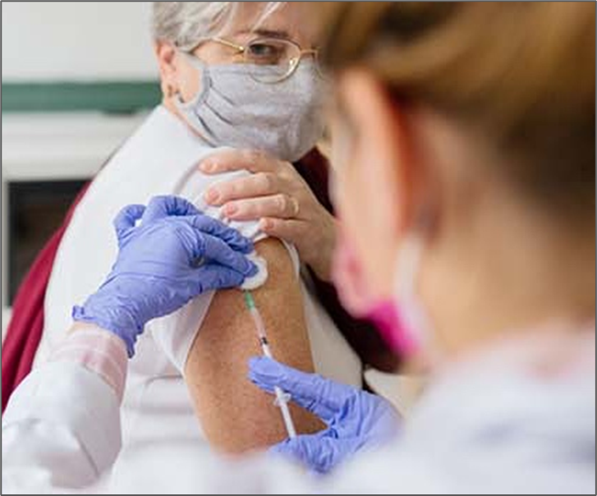
Benefits of Group Membership (Employed Physicians)
Enjoy convenient access to the tools and resources available to AOA members at a discounted group rate!
  Discounted live and on-demand CME activities
  An easy way to track CME, maintain AOA board certification and/or licensure through out physician portal
  Physician support services
  Credentialing verification through AOA Profiles
  Federal and state advocacy on behalf of Dos and osteopathic medical students
  Professional development and opportunities to grow your network
Notes:
Our Group Memberships provide all the same membership offerings that an individual membership provides. In addition to…

Slide 33

Additional Benefits of Group Membership (Organizations)
Save up to 60% off regular member pricing*
FREE Associate Memberships*​
UNLIMITED Resident/Fellow memberships​
Access to Town Hall with AOA Leadership​
Complimentary registration to OMED*​
Streamline membership dues payments with just one invoice​
Participating organizations acknowledged on our website with logo​
Speak to organization’s leaders about this new program and unlock discounted AOA benefits and services for you and your colleagues today.​
www.osteopathic.org/groupmemberships​
Notes:
Unlocking additional savings of up to 60% off of regular membership pricing. As well as:
FREE Associate Memberships*​
UNLIMITED Resident/Fellow memberships​
Access to Town Hall with AOA Leadership​
Complimentary registration to OMED*​
Streamline membership dues payments with just one invoice​
Participating organizations acknowledged on our website with logo​
Speak to organization’s leaders about this new program and unlock discounted AOA benefits and services for you and your colleagues today. For more information, you can visit: ​
www.osteopathic.org/groupmemberships​

Slide 34

GME Membership Program
Unlock discounted AOA benefits & services for GME programs
  The AOA also offers group membership options for GME training programs to help support the training of residents, fellows and interns.
    Offers access to the full extent of AOA membership at deeply discounted pricing. ​
    Provides unmatched resources in the areas of professional development, education, networking and physician services.​
    Designed exclusively to meet the needs of GME leaders, residents and fellows. ​
Notes:
Another special membership offering is the AOA’s: GME Membership Program.
The AOA also offers group membership options for GME training programs to help support the training of residents, fellows and interns.
This option offers access to the full extent of AOA membership at deeply discounted pricing. ​
Provides unmatched resources in the areas of professional development, education, networking and physician services.
And has been designed exclusively to meet the needs of GME leaders, residents and fellows. ​

Slide 35
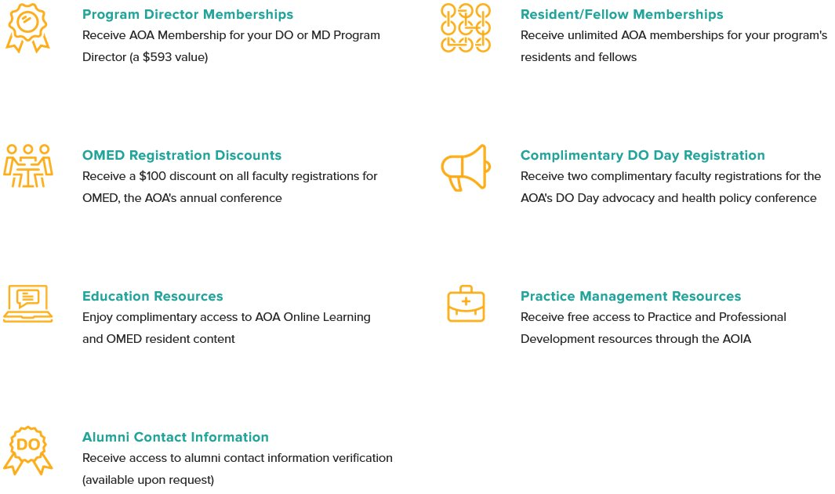
GME Membership Program Benefits
Notes:
Exclusive GME Membership Program benefits also offers:
Program Director Memberships
OMED Registration discounts
Educational Resources
Alumni Contact Information (available upon request)
Resident/Fellow Memberships
Complimentary DO Day Registrations
And Practice Management Resources

Slide 36

GME Membership Program
If you are interested or have questions about the GME Membership Program and/or Pricing, please contact: aoabilling@osteopathic.org​
If you would like to learn more about obtaining Osteopathic Recognition for your program, please contact: postdoc@osteopathic.org
Notes:
If you are interested in taking advantage of the GME Membership Program, pricing, and/or if you have any questions, please contact: aoabilling@osteopathic.org

Slide 37

Invest in Your Future with AOA Membership
We are here to advocate for you and help support you throughout your entire career.
Join the AOA today to gain access to our ever-growing list of benefits and resources.
Our thriving and diverse community is stronger when we stand and face the future together.
Together, we are #DOProud.
Notes:
I like to think of AOA Membership as an investment in your career and future with membership benefits simply being a perk, however for many the value of AOA Membership saves them time, energy, stress, and money. There is peace of mind that comes with being a Member and knowing that the AOA advocates and support us throughout our careers.
I encourage you to join today to start taking advantage of all of the resources the AOA has to provide as we are stronger together.

Slide 38

You Care for Your Patients, Let Us Care for You
Questions and don’t know where to go?
Our Member Resource Center is here to help answer your questions and assist with:
  CME
  Board certification
  Member benefits
  Student and Resident affairs
  Event registration
  And more!
For assistance, please contact the MRC:
  Phone: (312) 202-8000, select Option 1
  Email: MemberService@osteopathic.org
Notes:
With so many offerings, it’s natural to have questions. The AOA’s Member Resource Center is a dedicated one-stop shop for all of your needs. Whether you have questions on getting started, taking advantage of your AOA Membership, how to find and access any of your benefits, or you have questions but you don’t know where to go; AOA staff will have answers or connect you with the appropriate departments to ensure that you’re taken care of.
If you’re interested in joining the AOA, you can do so at any time online at osteopathic.org. Simply log in and click “Join the AOA” at the very top of your screen. If you have log in issues, or if you’d prefer to join over the phone, simply call the Member Resource Center, and a staff member will be able to assist you from there.
Feel free to take a picture of this slide, or write down the contact information provided. The Member Resource Center is available by phone Monday through Friday, 8:30am to 4:30pm CST, or by email at: memberservice@osteopathic.org.

Slide 39
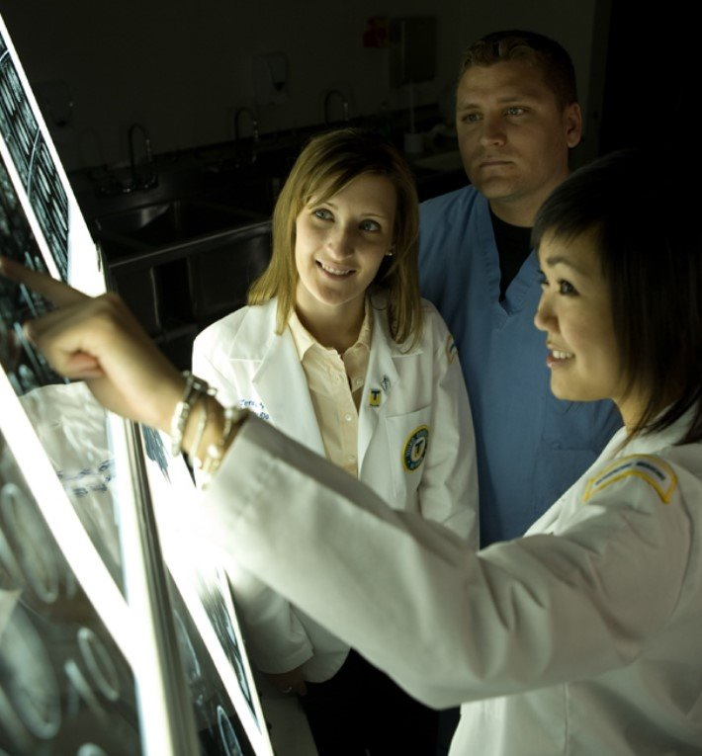
How Can I Get More Involved?
Join our communities to stay connected
  Osteopathic Pride Campaign
  Osteopathic Advocacy Network (OAN)
  My AOA mobile app
Notes:
If you’re interested in getting more involved, here are a few opportunities that will be open to you:

Slide 40
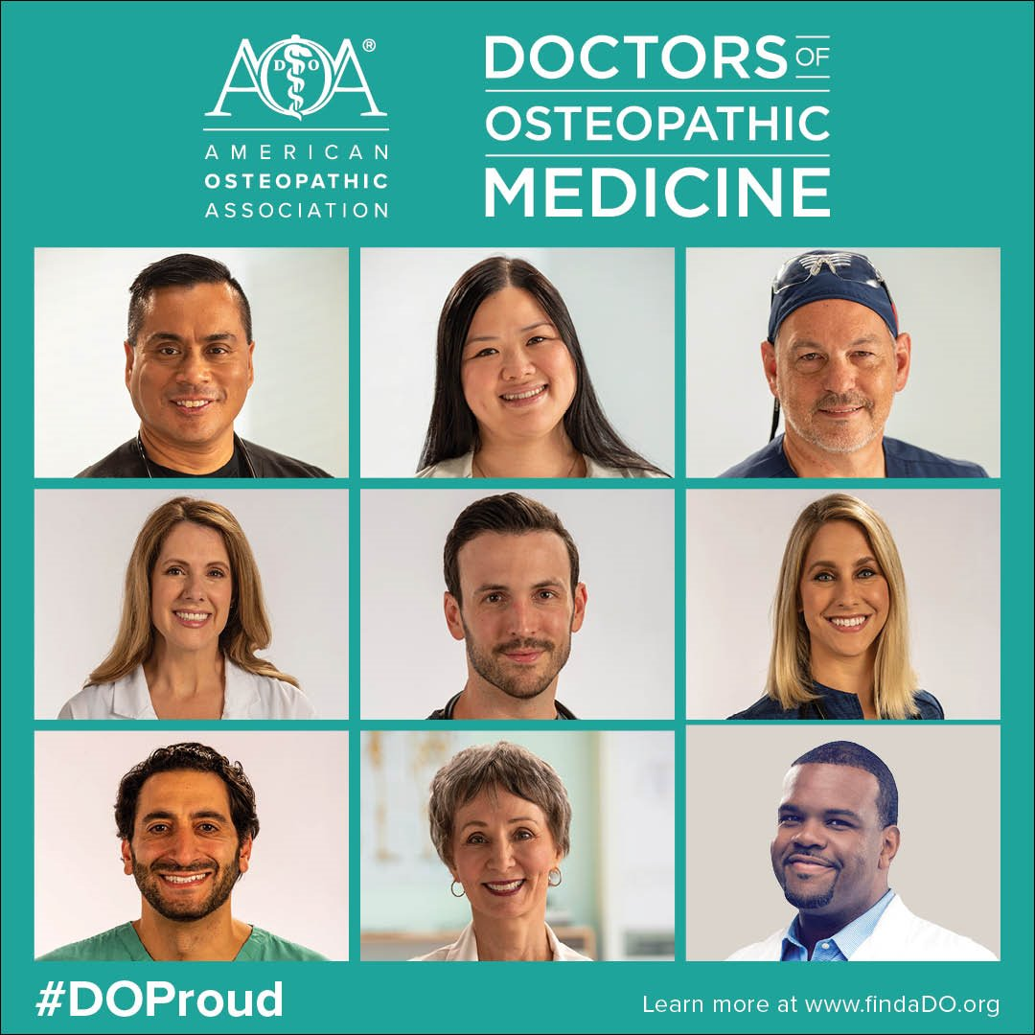
Living #DO Proud
Osteopathic Pride Campaign
  Honor the distinctiveness of osteopathic profession​
  Celebrate the unique training, perspective and approach of DOs​
  #DOProud on AOA social media channels and The DO
www.osteopathic.org/DOProud
Notes:
The AOA’s Osteopathic Pride Campaign focuses on highlighting the tremendous contributions of DOs and osteopathic medical students using #DOProud [hashtag – DO – Proud].
The campaign features real DOs from various specialties, backgrounds and career stages.
Throughout the year ahead, we share the distinctiveness of what it means to be an osteopathic physician.

Slide 41

Osteopathic Advocacy Network (OAN)
Building relationships with lawmakers
Engage in federal and state advocacy
Build influence in DC
Support AOA strategy
Help get legislation passed
Shape the future of osteopathic medicine
Osteopathic.org/grassroots
1st Wednesday every month
Notes:
The AOA is working on your behalf every day, but you are the best advocate for the osteopathic profession and your elected officials must hear from you. That’s why we created the Osteopathic Advocacy Network (OAN). It’s designed to bring osteopathic physicians, residents and students together to engage in advocacy at a higher level.
We need your support. We can only be as good as your support allows because there’s power in numbers.
We need your help in building better relationships with your lawmakers in order to pass legislation that not only benefits the osteopathic community but the patients we serve.
The most important thing to keep in mind is that your members of Congress really want and need to hear from you. They truly value staying in touch with constituents, and as osteopathic medical students and leaders of our profession, you are the subject matter experts on healthcare related topics and the conversations that you have with your lawmakers will really help guide and craft policy.
The AOA is shaping the future of osteopathic medicine through the Osteopathic Advocacy Network and if you want to take part in this movement, join today—like I said, there is power in numbers and this is truly a win-win situation... For you, for us, for our osteopathic community. Honor the profession.

Slide 42
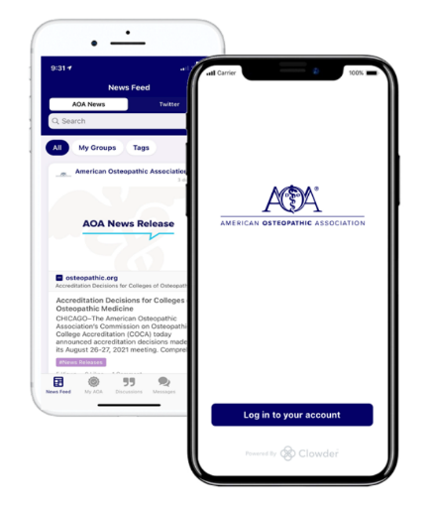
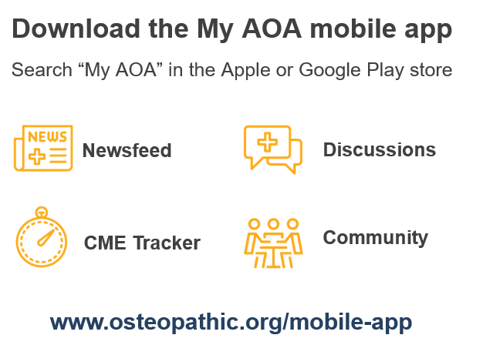
Let’s Stay Connected!
Notes:
In addition to our websites and social media, we have an easy new way for you to stay connected to the AOA and your colleagues in the osteopathic profession.
If you haven’t already, I encourage you to take a moment to download the app - it’s available in the Apple and Google Play app stores.
Once you download, you’ll receive all the latest updates from the AOA in one convenient location – no matter your specialty or career stage, you’ll find content, tools and resources personalized for you, including CME tracking tools, updates from The DO and Journal of Osteopathic Medicine and advocacy engagement opportunities.
One of the most exciting features you’ll find in the app is a Discussions and Community area where you can connect with other DOs and osteopathic medical students and participate in discussions with other members of the profession.
The AOA continues to add new features regularly, so stay tuned for new updates and capabilities coming soon!

Slide 43
Thank you
Speaker Name & Credentials
Notes:
Thank you so much for your time today. If you would like to get more information on the AOA and Membership or have a staff member of the AOA reach out to you directly, I will have a sign-up sheet up here.
Thank you again, and I hope you consider joining me as a proud member of the AOA!

